Slide 1
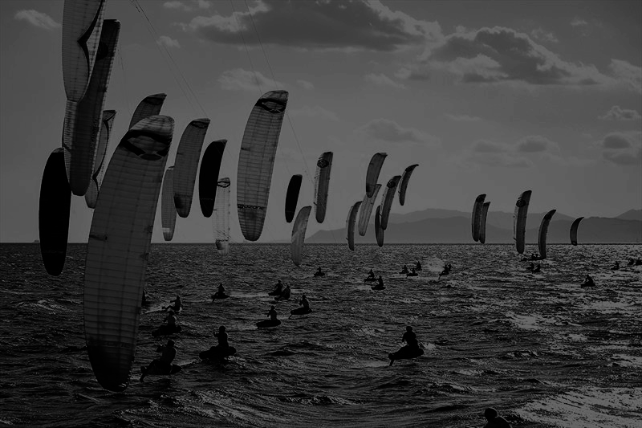
Performance Analysis
First Upwind Leg
2025 Formula Kite World Championships
A GPS-based performance analysis comparing Riccardo Pianosi and Maximilian Maeder, the top two athletes of the 2025 Formula Kite World Championships Final.
Nicolò Nucci
matr. 945678
n.nucci@campus.unimib.it

Slide 2
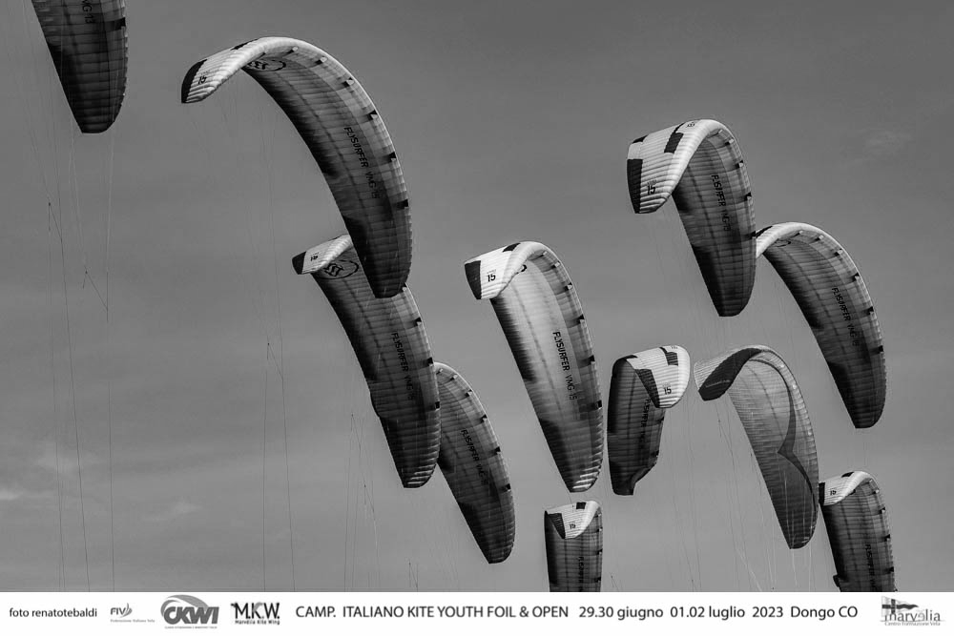
Research questions
Main Research questions
How do technical and strategic choices during the start phase and the tacking manoeuvres influence overall performance on the first upwind leg in a Formula Kite race?
How do Pianosi and Maeder differ in their acceleration patterns and speed development during the start window, and how do these differences affect their initial upwind progression?
How does the execution of tacking manoeuvres—considering speed loss, VMG drop, turning radius, and recovery time—impact each athlete’s ability to maintain efficient progress toward the wind?

Slide 3
Data Sources
The GPS tracks used in this study were downloaded from the public platform metasail.it, event archive:
Data are provided in GPX format, containing timestamped latitude–longitude points for each athlete.
Methodology Overview
Speed, acceleration, VMG, Distance Lost, and Turn Radius were computed using custom Python scripts.
Start line, finish line, and marks were approximated because no official GPS coordinates were provided.
Tack moments were manually identified due to insufficient granularity to detect them algorithmically.
Reproducibility
The entire analysis pipeline is deterministic.
All results can be reproduced exactly using the same GPX files and manually selected tack timestamps and influent points

Slide 4
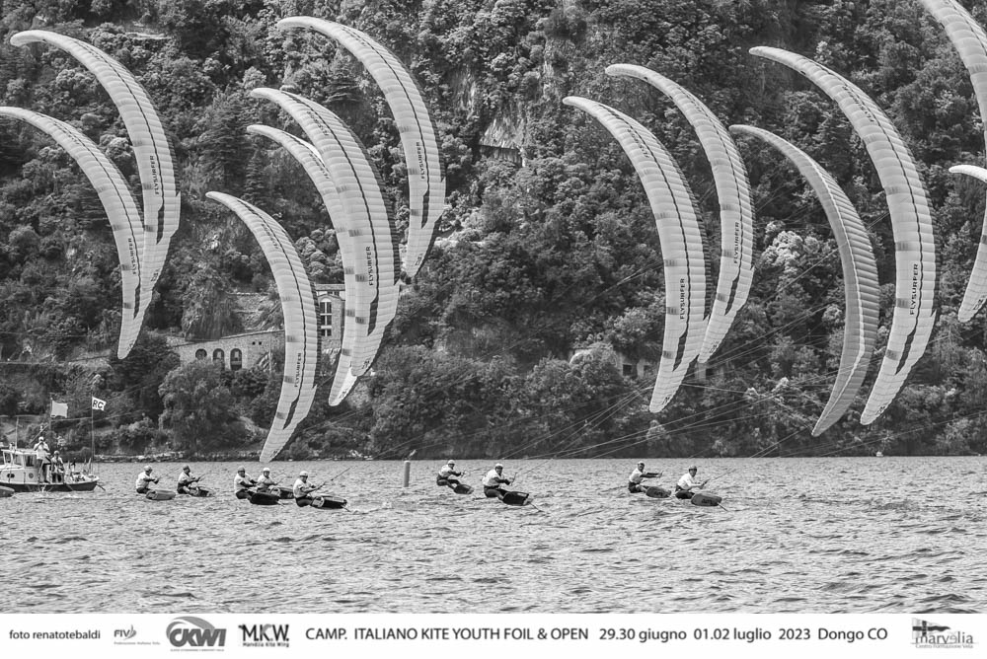
About data
Data Sources and Structure The analysis is based on three primary components: the raw GPX tracks of Riccardo Pianosi and Maximilian Maeder, the Excel file Formula Kite Men FINAL.xlsx and a set of manually annotated tack timestamps. The GPX tracks provide high-frequency geo-referenced coordinates, enabling the reconstruction of trajectories and the computation of key performance metrics such as Speed Over Ground (SOG), Velocity Made Good (VMG), curvature radius, and distance lost during manoeuvres.
Critical Issues and Limitations
The dataset has several intrinsic limitations. No official coordinates were provided for the start line, marks, or finish line; all these elements were reconstructed computationally using geometric offsets, introducing unavoidable spatial uncertainty. Tacks are not encoded in the GPX files and cannot be detected automatically with sufficient precision due to computational limits. Tack events were identified manually by inspecting the trajectories, SOG profiles, and race simulation. Additional data-quality issues include GPS jitter and slightly irregular sampling frequency, although these affect both athletes symmetrically and do not compromise comparative analysis.
Data Cleaning & Preparation Preprocessing tasks included filtering GPS points, correcting temporal anomalies, converting latitude–longitude coordinates into a local metric frame, extracting time windows around the start and tack events and computing derived metrics such as SOG, acceleration, VMG, and curvature radius. These operations ensured a coherent and analysis-ready dataset.

Slide 5
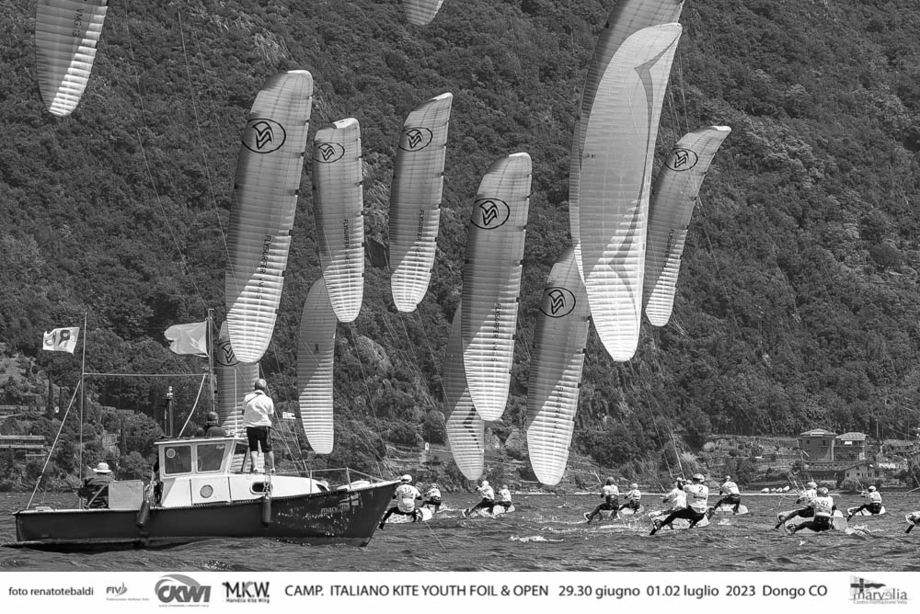
Methodology
Processing Pipeline and Tools The full analysis pipeline was implemented in Python, using gpxpy for parsing GPS data, numpy for numerical processing and matplotlib for visualization. No external APIs or web scraping were required. The code reconstructs the racecourse geometry through trigonometric offsets, projects geographic coordinates into a 2D metric system and extracts analysis windows around manoeuvres and around the start.
Analytical Techniques Metrics are computed through both descriptive and kinematic methods: speed before/during/after the tack, VMG loss, curvature radius estimation, distance lost, and recovery time. For the start analysis, symmetric 10-second windows around the official start time allow comparison of acceleration behaviour. Maps, trajectory plots, SOG and acceleration profiles, and normalized comparison charts (as radar plots) provide a clear visual interpretation of performance differences between the athletes.
Reproducibility The entire workflow is fully deterministic. Given the same GPX files and manually annotated tack timestamps, all metrics and visual outputs are reproduced exactly. AI tools were used only for technical assistance, code refinement and documentation—not for data generation or modification. This guarantees transparency of the methodology and full reproducibility of the results.
https://github.com/nicolonucci/GPS-Analysis-of-the-2025-Formula-Kite-World-Championships

Slide 6
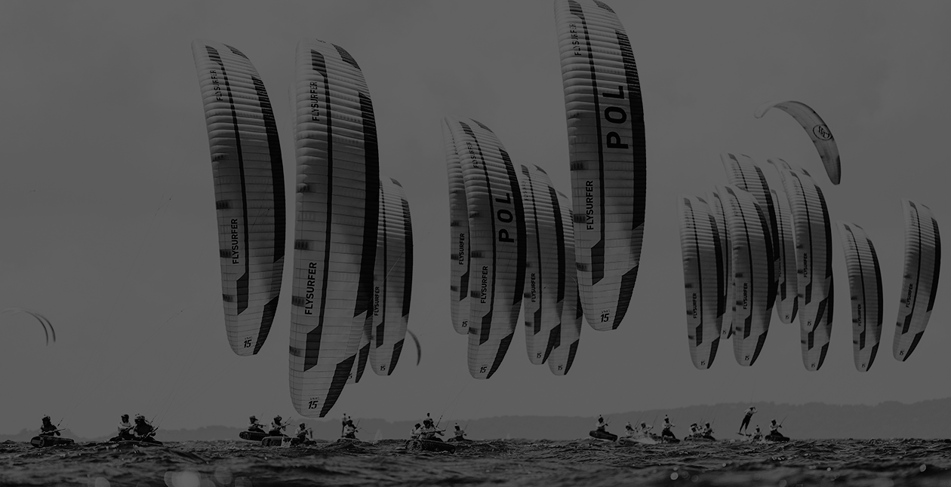
Sailing knowledge
A Formula Kite race is sailed around a fixed course marked by buoys. The first leg is an upwind section where athletes must advance against the wind by performing a sequence of tacks.
Turn Radius / Distance Lost: Indicators of maneuver efficiency. Smaller radii or higher speeds do not necessarily imply better upwind progress.
The Start Line is a imaginary line separating riders from the beginning of the race. Crossing early results in a penalty.
Speed over Ground (SOG): The actual speed measured relative to the Earth's surface.
Key concepts
Tack: A maneuver where the athlete turns the board through the wind to change direction, essential for upwind progression.
Velocity Made Good (VMG): The effective component of speed directed toward the upwind mark.

Slide 7
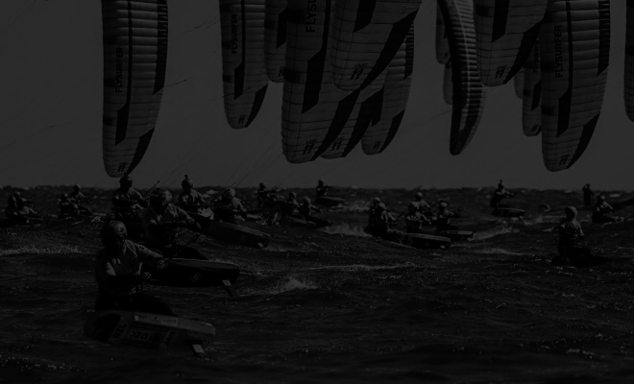
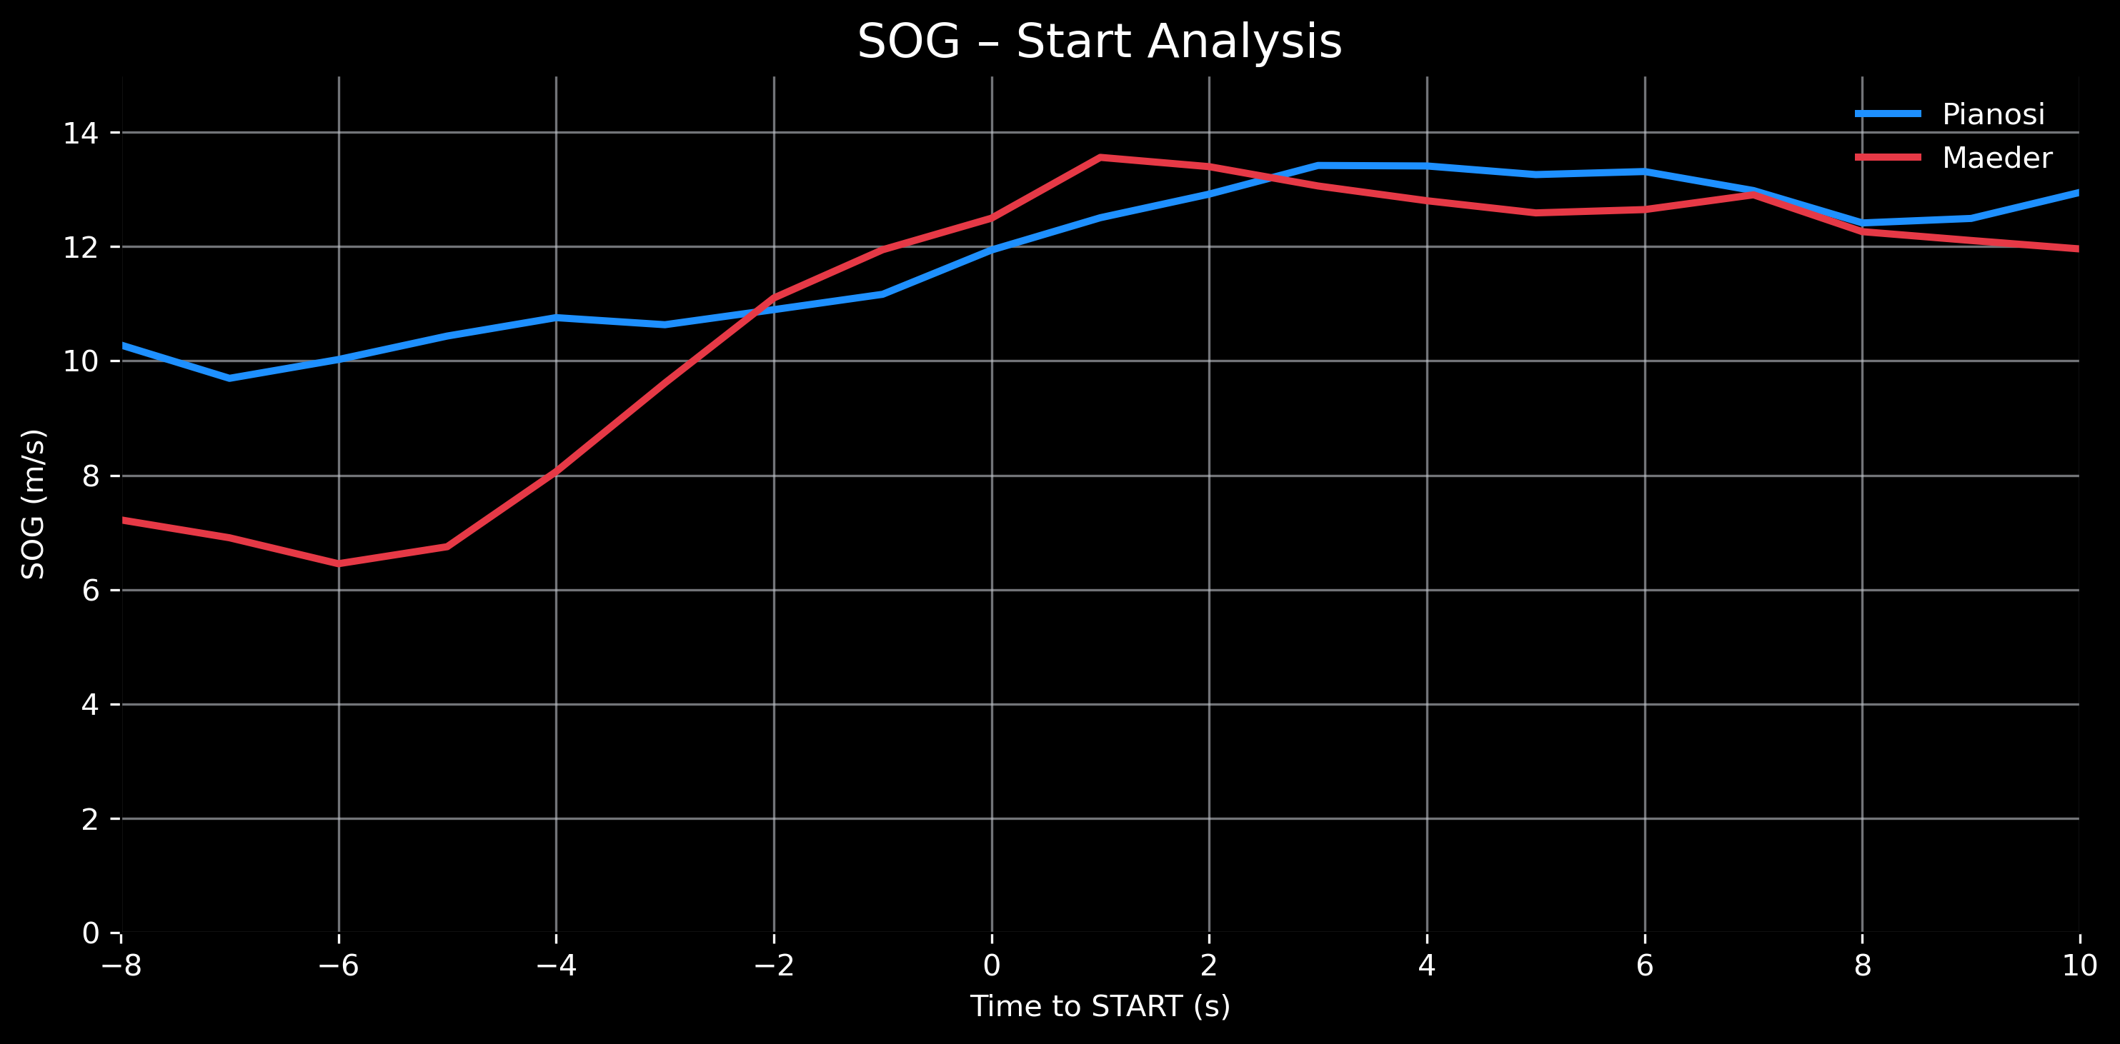
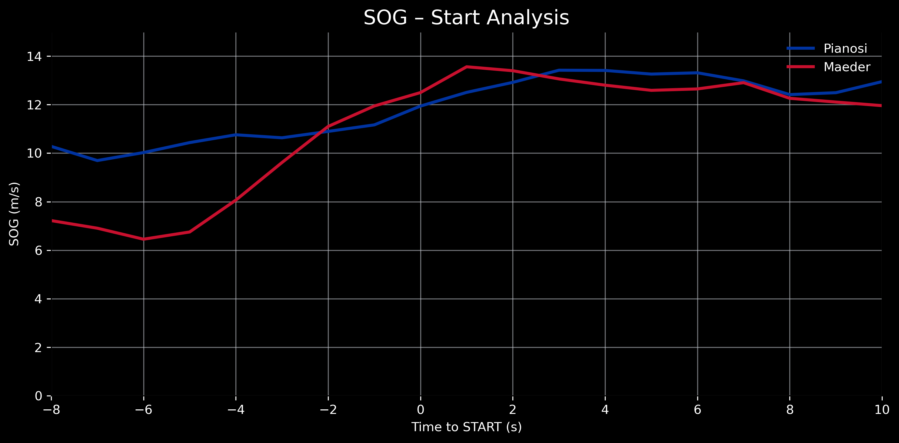
Start Phase: Speed (SOG) Analysis
Pianosi maintains a stable and high pre-start speed
Maeder approaches the line slower and relies on a sharp acceleration to recover
Right after the start, Maeder briefly surpasses Pianosi with a peak of 13.5–14 m/s.
Overall, Pianosi enters the race with stability, while Maeder adopts a more explosive but variable approach.

Slide 8
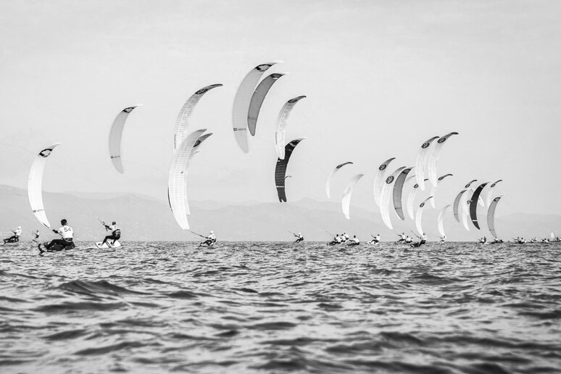
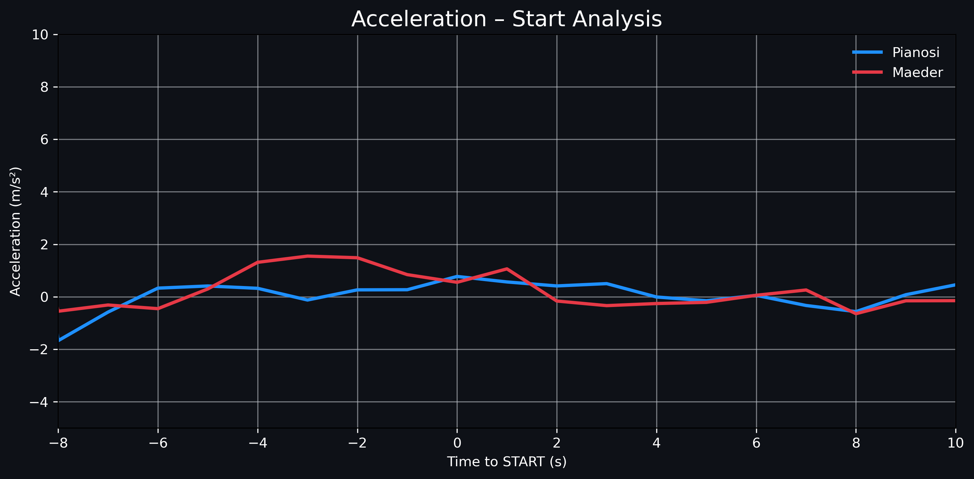
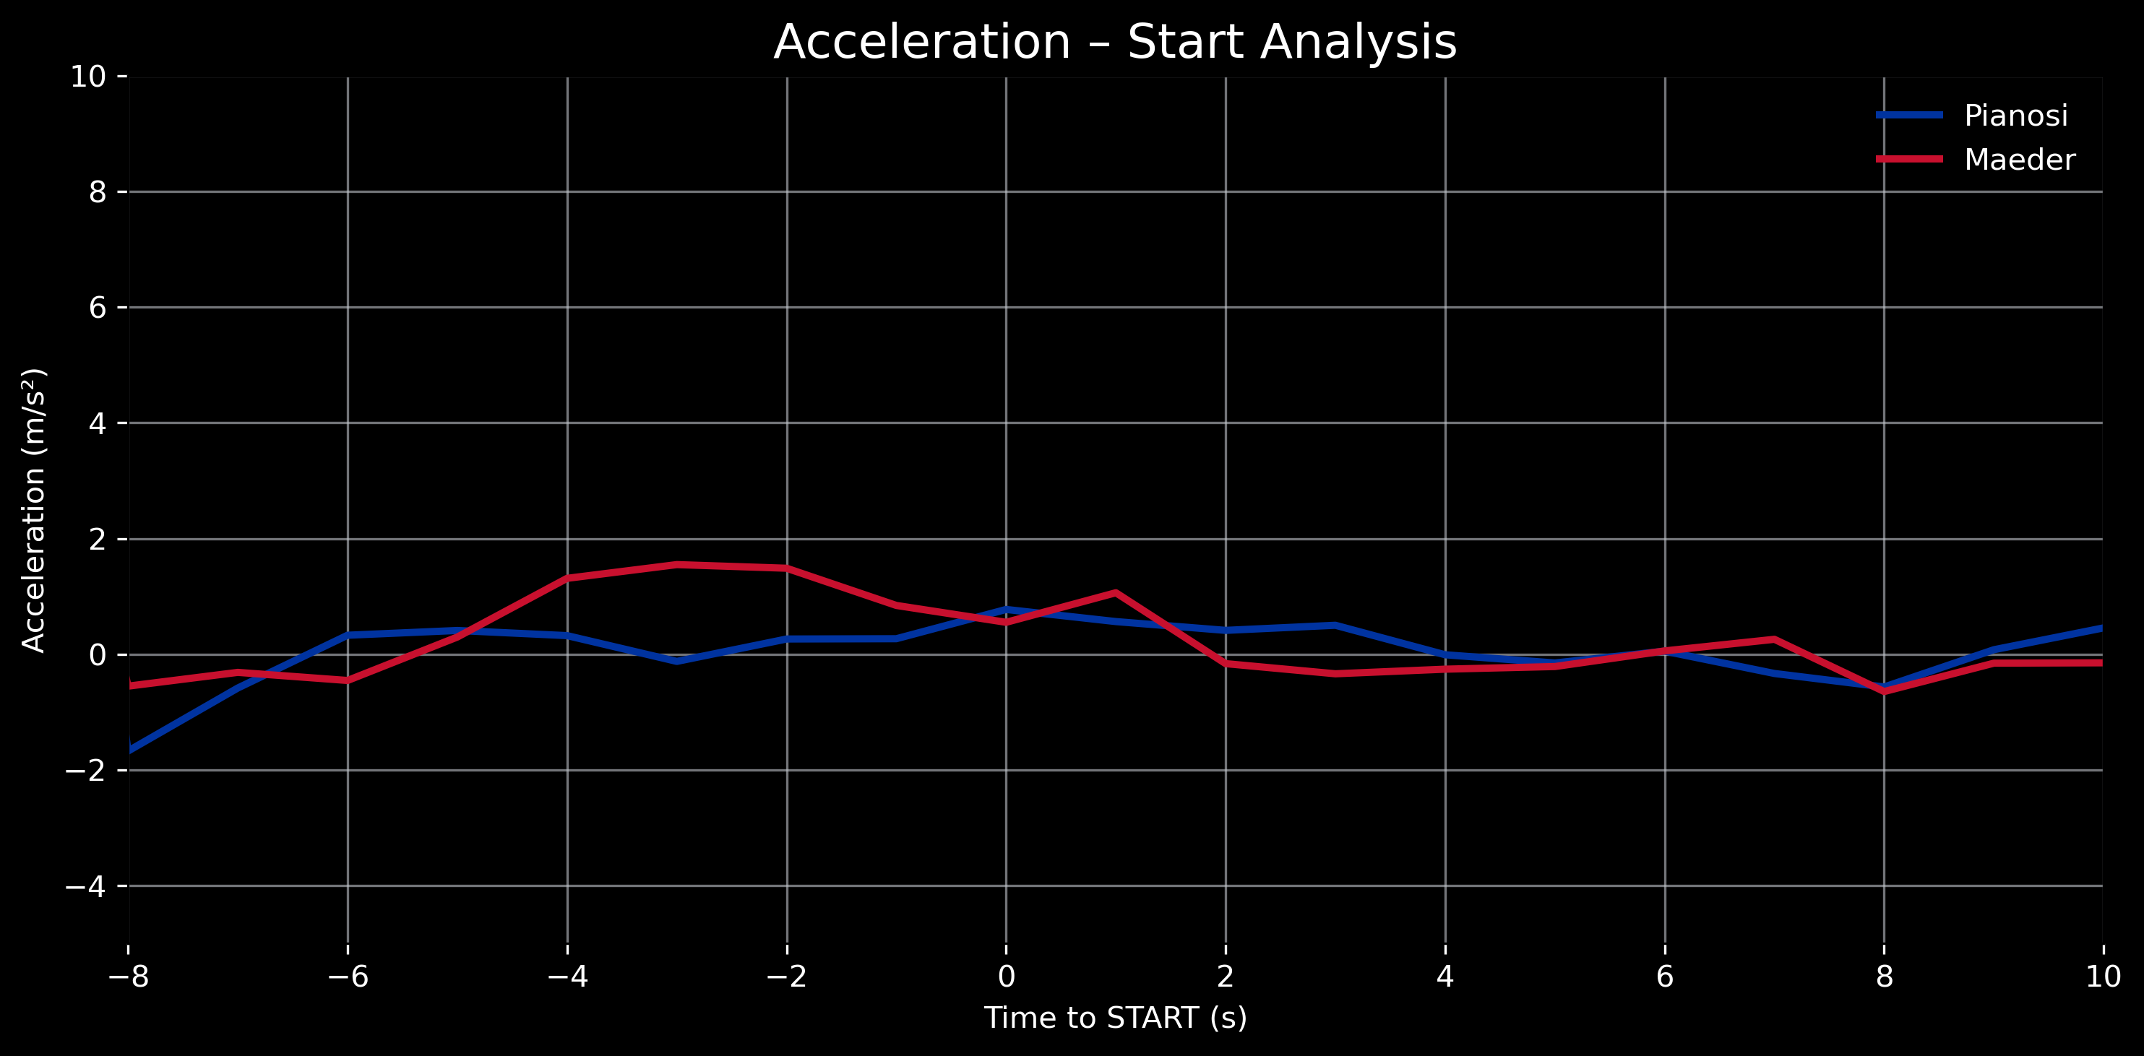
Acceleration Around the Start
Pianosi maintains a smoother and more stable acceleration range
Maeder produces a strong acceleration ramp between −5s and −2s
After the start, both stabilize, though Maeder shows a brief deceleration followed by a secondary acceleration spike
Maeder’s aggressive acceleration compensates for his lower entry speed but increases variability. Pianosi’s steadier approach limits fluctuations and promotes greater control during the critical pre-start phase.

Slide 9
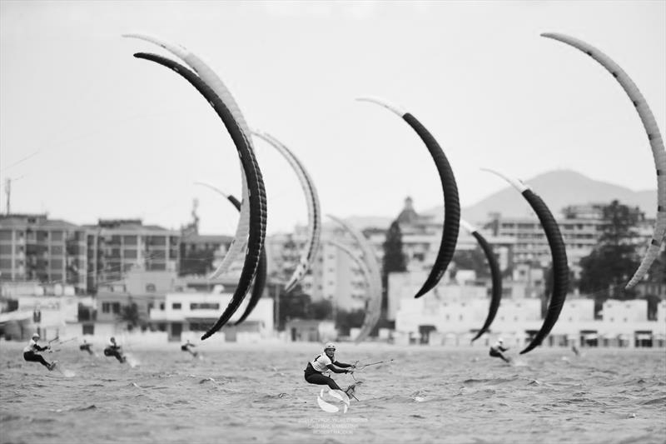
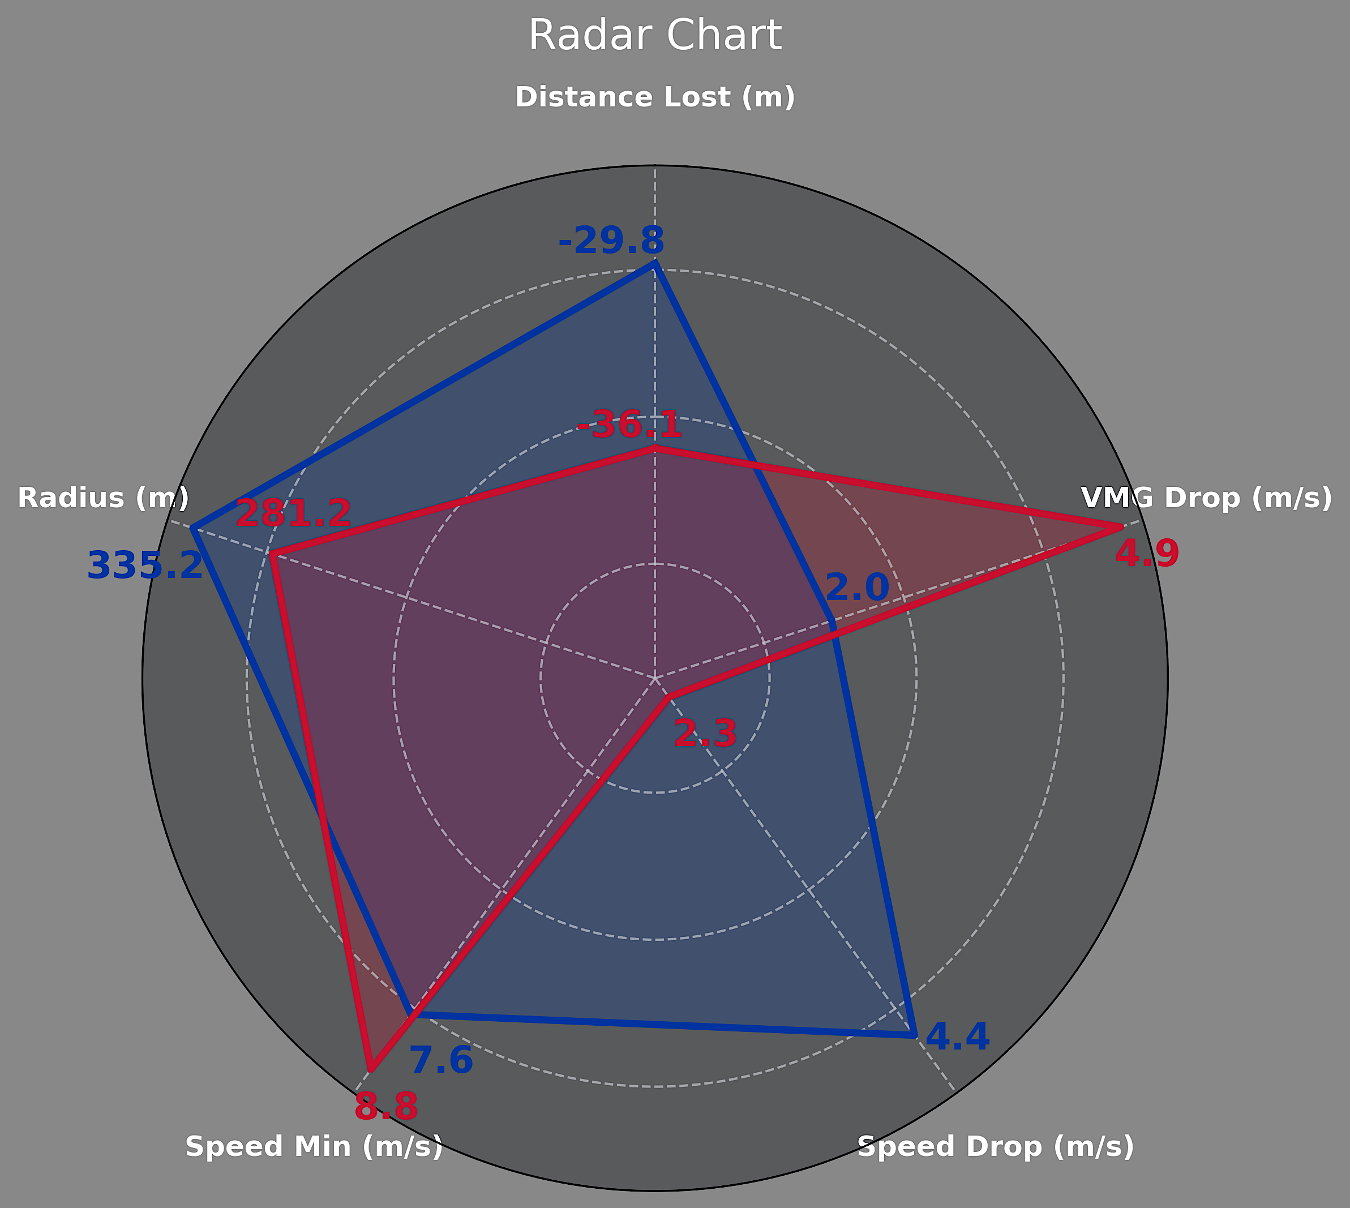
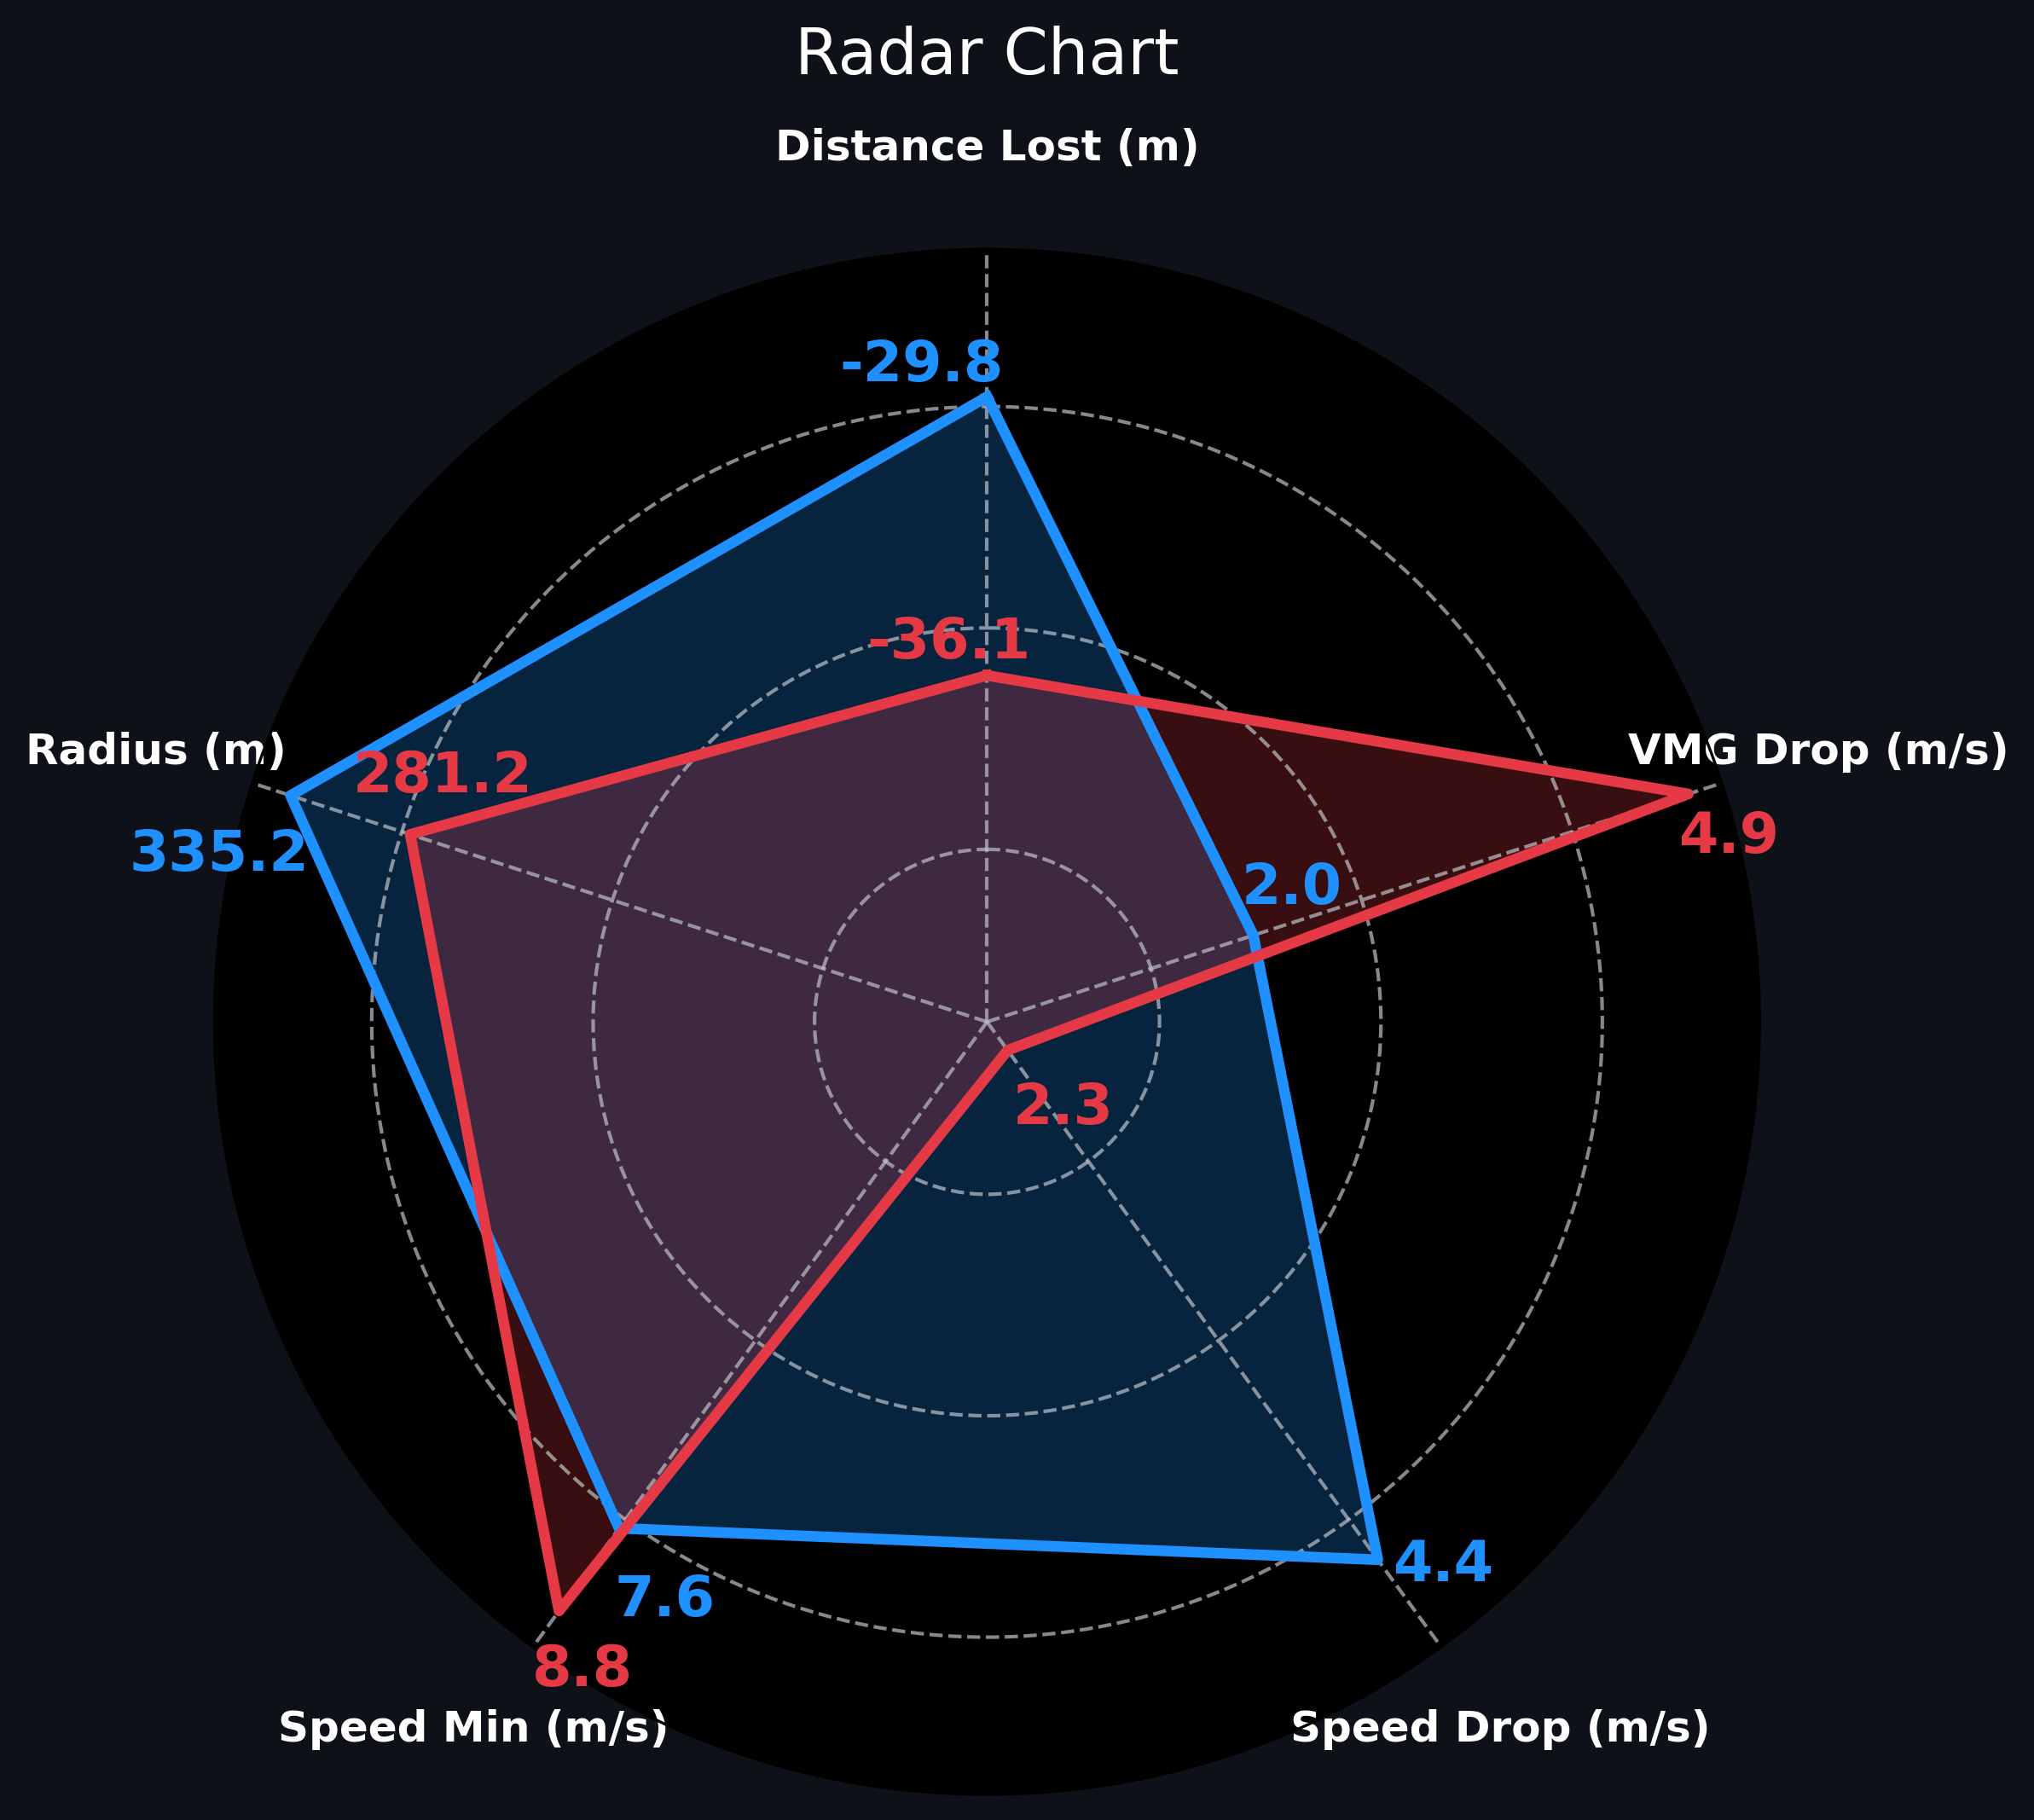
First Tack Analysis
Maeder preserves a higher minimum speed and performs a tighter turn radius.
Pianosi shows a deeper speed drop but completes a smoother and wider maneuver
Distance Lost: Pianosi loses 6.3 m less than Maeder
VMG Drop: Pianosi’s VMG reduction is less than half of Maeder’s
Maeder’s maneuver is mechanically sharper, but Pianosi’s tack is strategically more efficient, prioritizing alignment with the wind and maximizing effective progress. A technically clean turn does not always translate into optimal upwind efficiency

Slide 10
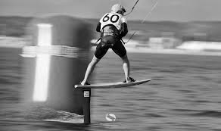
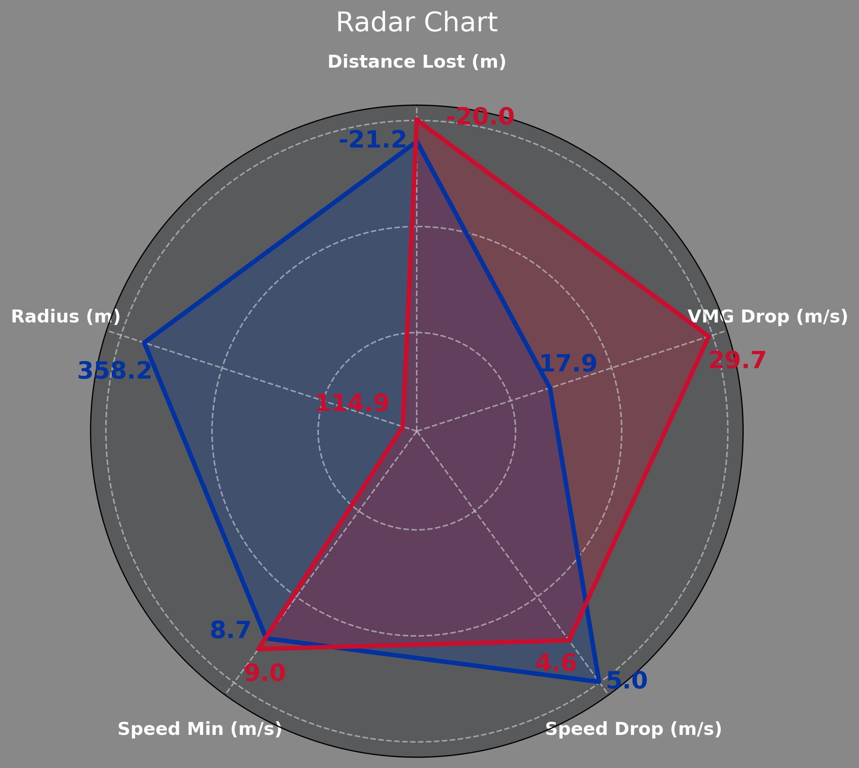
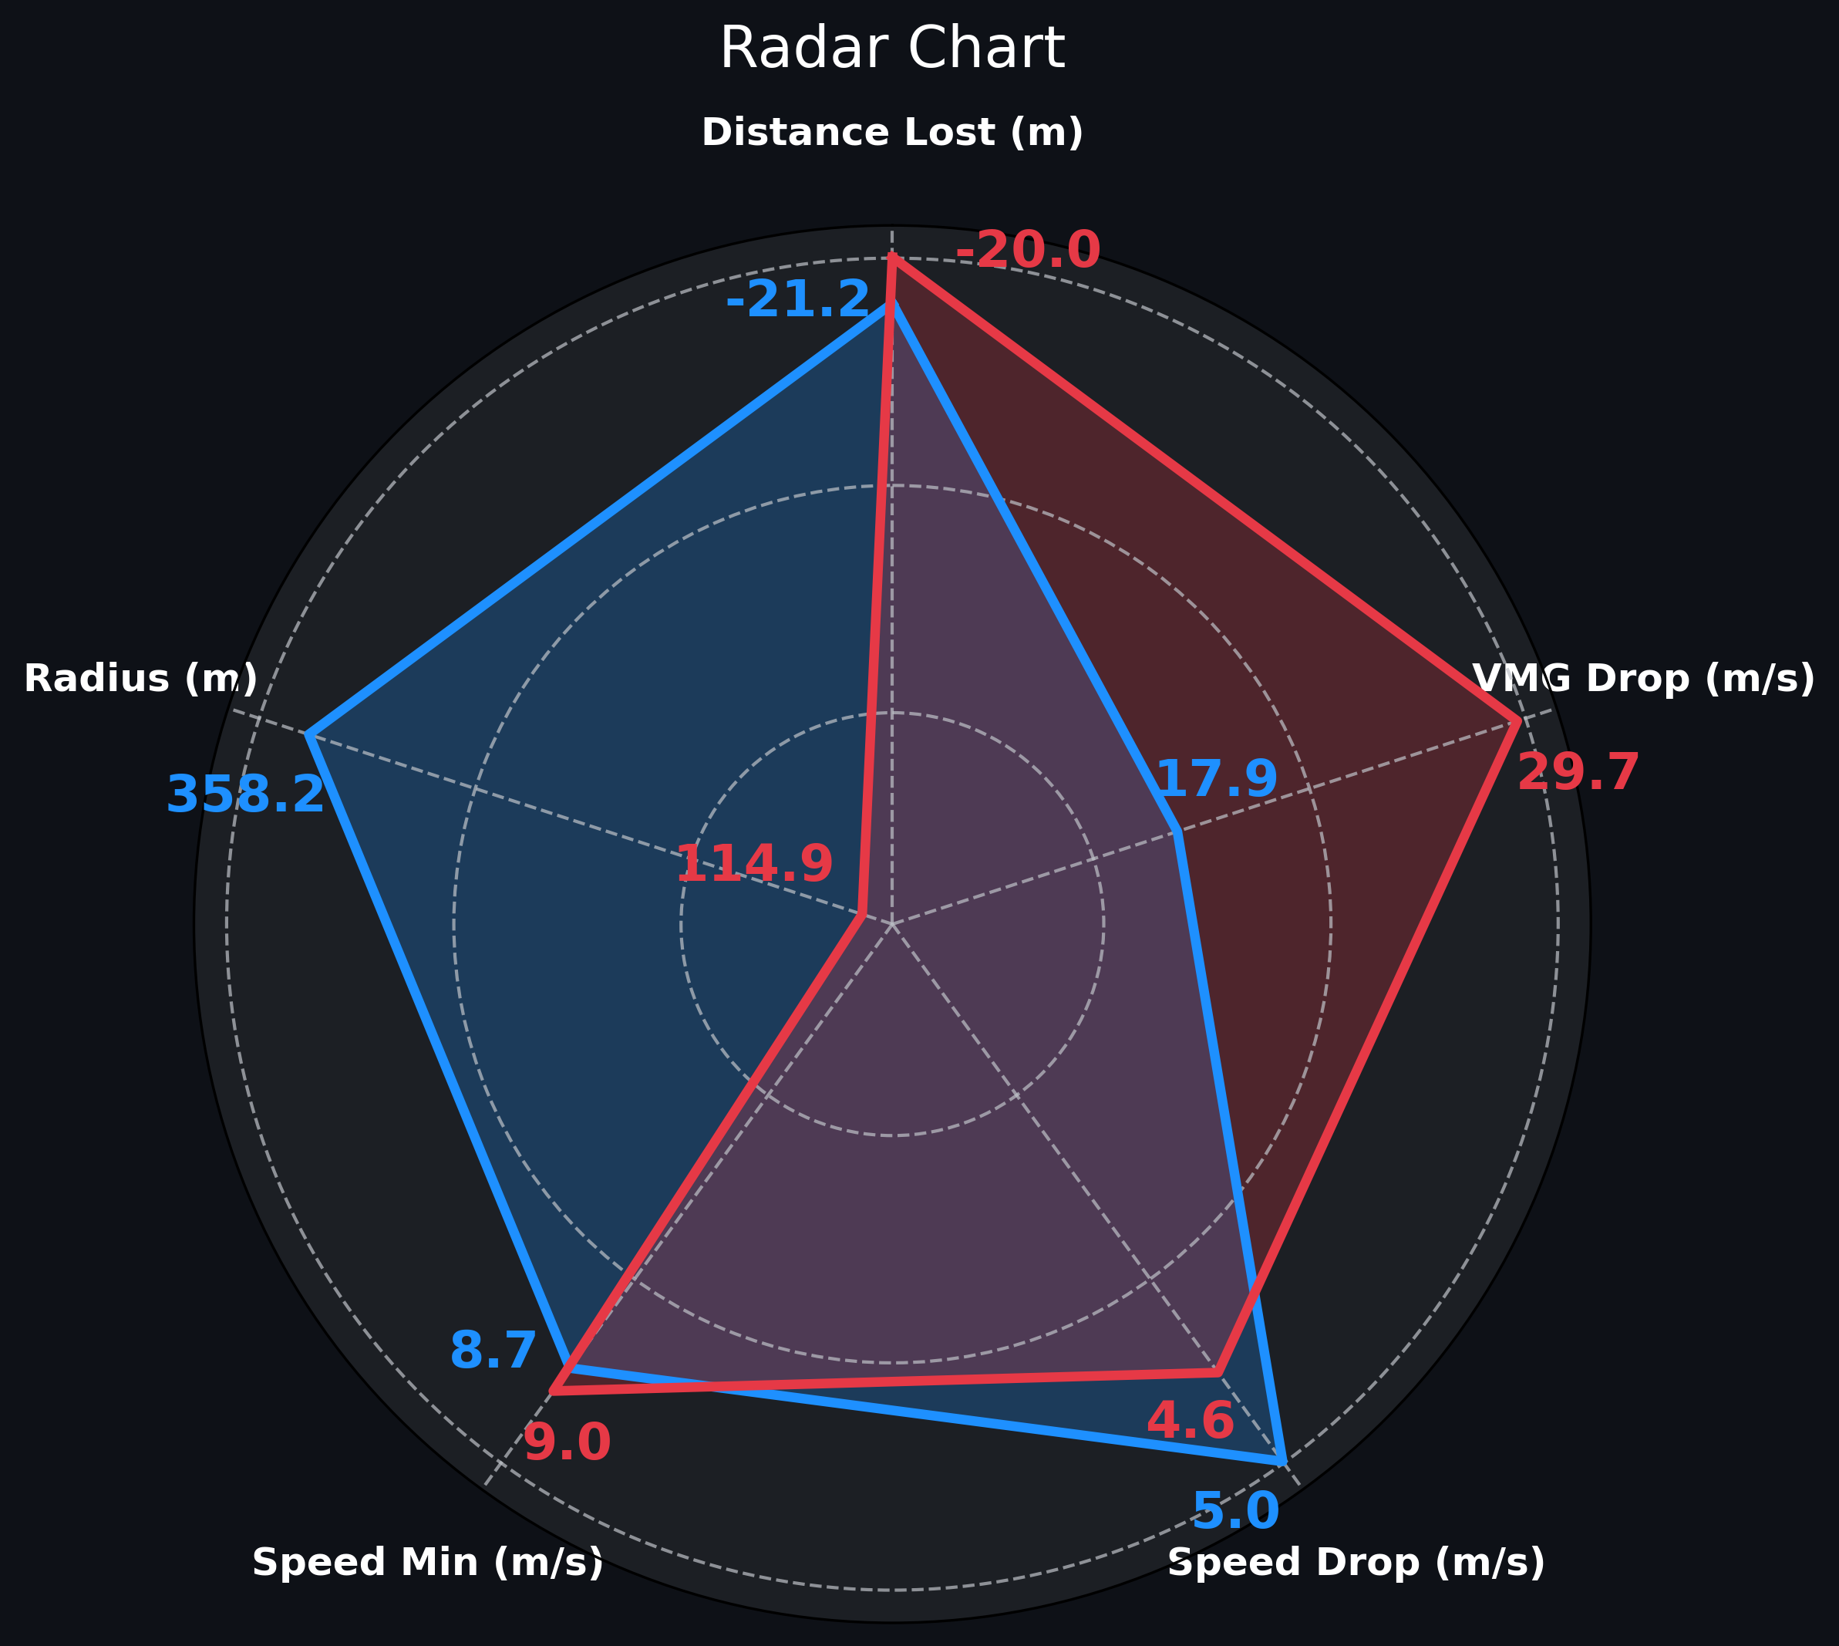
Second Tack Analysis
Maeder executes an extremely tight tack with a turn radius nearly three times smaller than Pianosi’s
Both athletes maintain high minimum speeds, with Maeder again showing a slight advantage
VMG Drop: Maeder loses 29.7 m/s, far exceeding Pianosi’s 17.9 m/s — a substantial tactical disadvantage
Maeder’s aggressive maneuver maximizes raw speed but compromises heading efficiency, leading to reduced effective upwind progress. Pianosi’s more conservative turn preserves a stronger tactical trajectory toward the mark. High speed alone does not guarantee good upwind performance — directional efficiency is equally critical

Slide 11
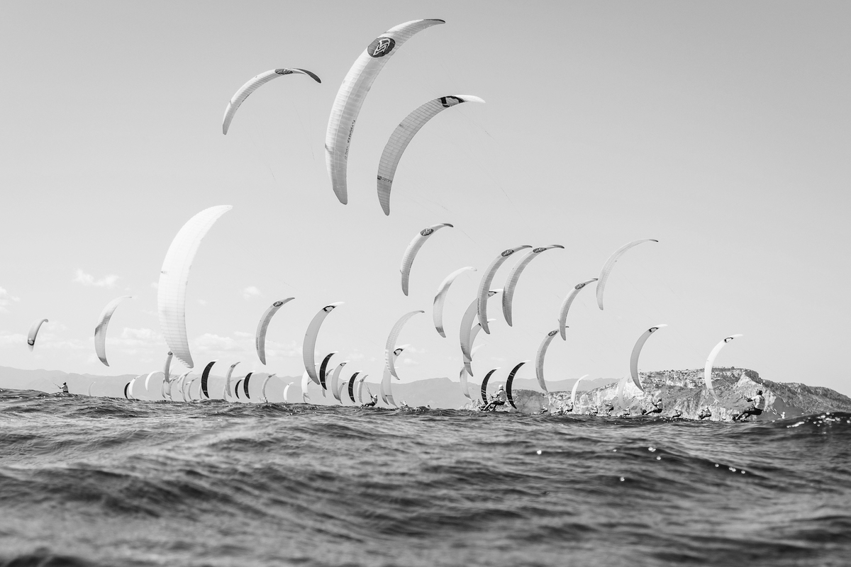
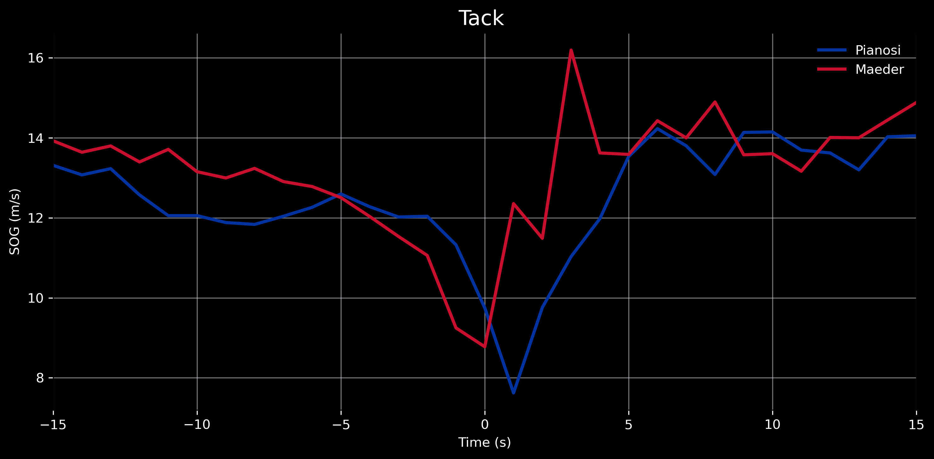
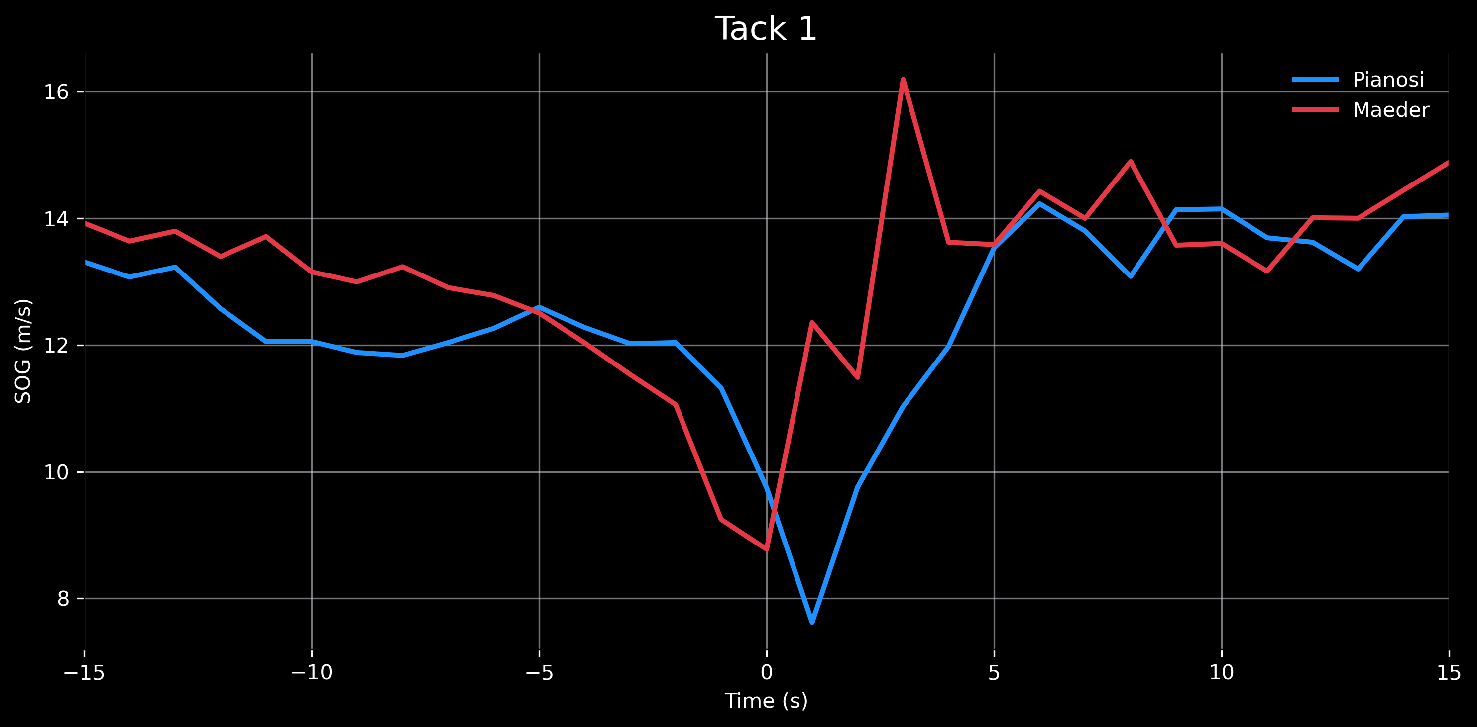
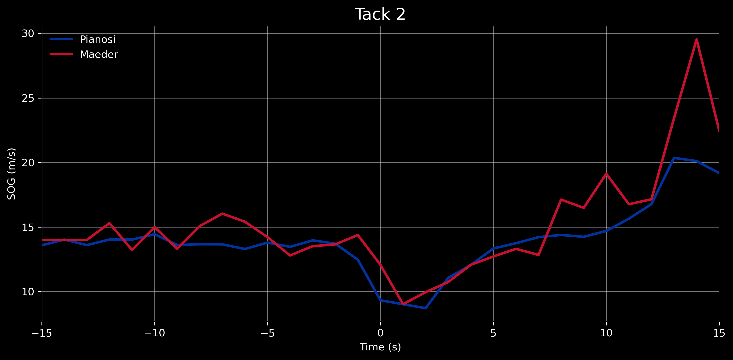
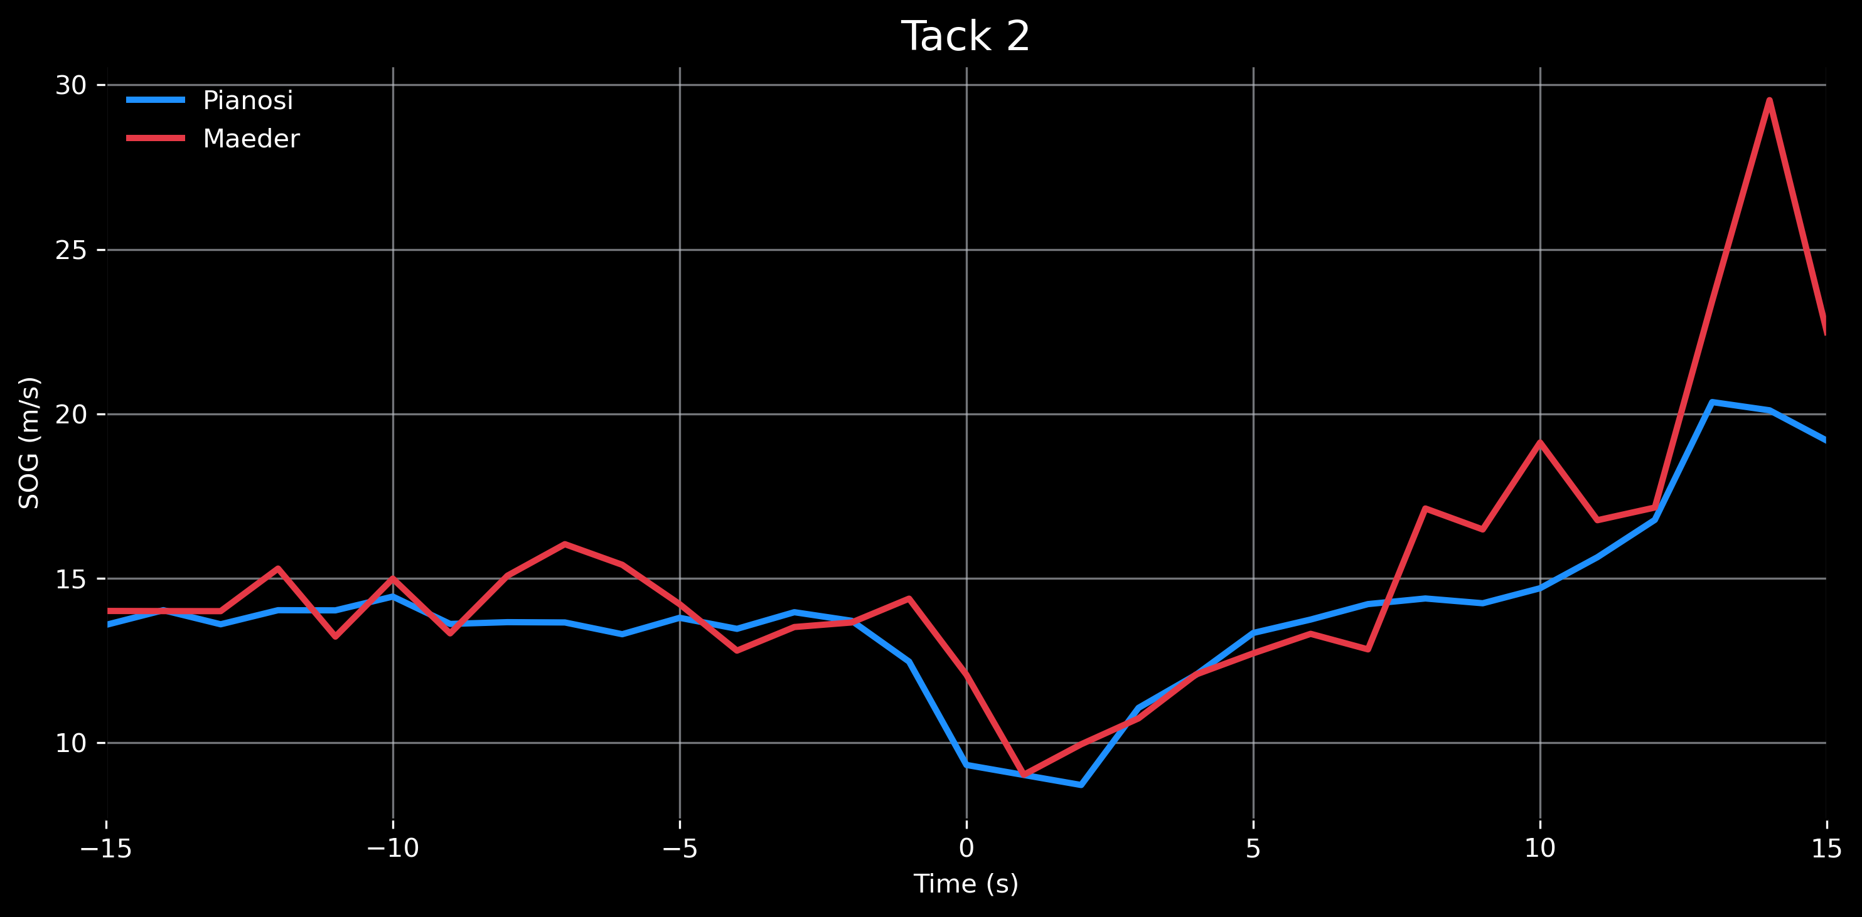
Speed Comparison During Tacks
Maeder produces strong post-tack acceleration spikes, reaching up to 29 m/s
Pianosi exhibits deeper speed minima but a more controlled and stable recovery
The pronounced spikes in Maeder’s profile correspond to greater heading deviations, which align with his larger VMG losses
Explosive speed spikes highlight strong power output but often reflect a less efficient upwind angle. In contrast, Pianosi’s smoother speed evolution suggests a more strategically optimized trajectory toward the mark.

Slide 12
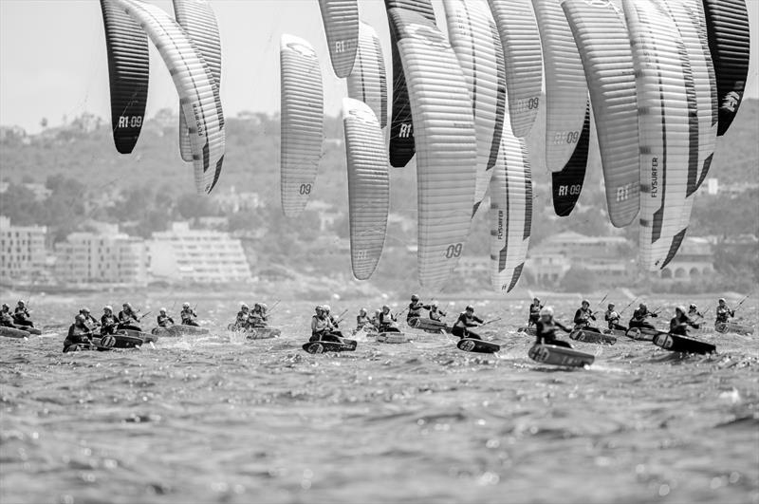
Final Conclusions
Maeder relies on sharp accelerations and tight turns, achieving higher short-term speeds but at greater tactical cost
In both tacks, Pianosi preserves significantly more VMG, gaining more effective distance toward the upwind mark
Maeder’s mechanical superiority is offset by larger directional inefficiencies
Pianosi shows superior baseline stability, smoother accelerations, and more consistent control during the start
In conclusion, in upwind racing efficiency and trajectory optimization outweigh sheer speed. Pianosi’s approach converts a larger portion of his motion into real tactical advantage, explaining his stronger performance in the first leg.

Slide 13
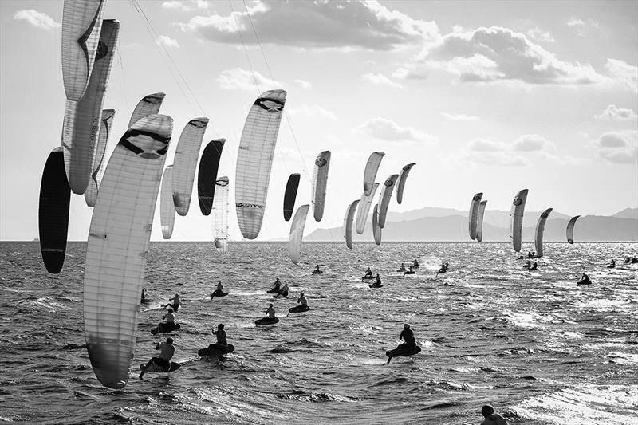
Legal and Reproduction Notes
Data Availability
GPS tracks are publicly accessible and downloadable from metasail.it
No personal or confidential data were used.
Usage Rights
All analysis, visualizations, and metrics are produced exclusively for educational and research purposes.
Images and GPX data are used under publicly accessible terms provided by the hosting platform.
Slides are shared with the following license:
‘GPS Analysis of the 2025 Formula Kite World Championships' by Nicolò Nucci, is licensed under a CC BY-NC-ND 4.0 license

